Slide 1
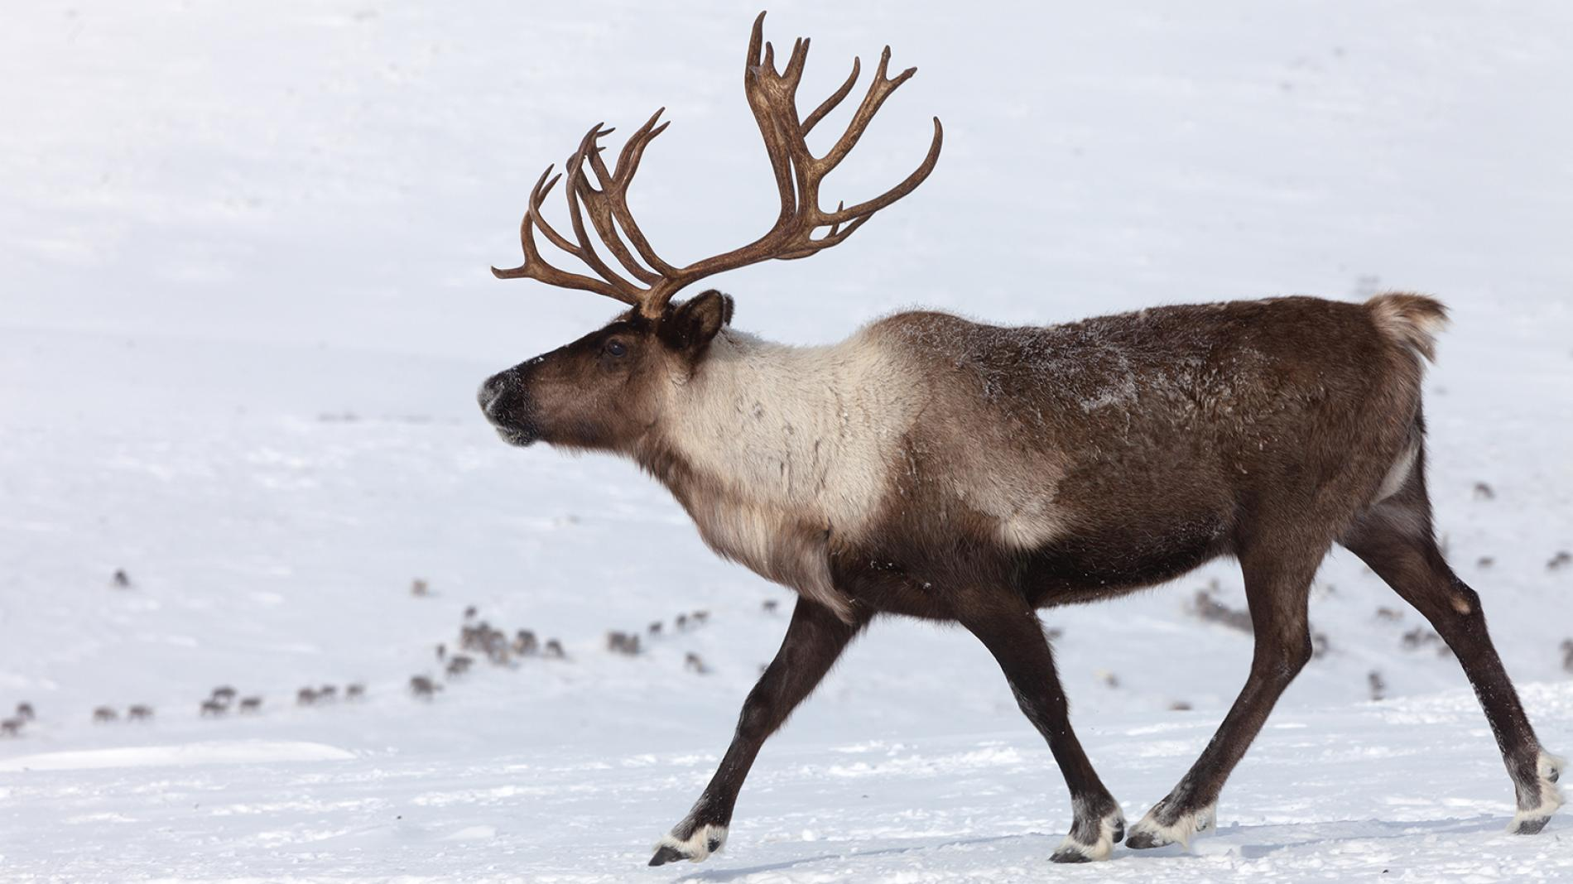
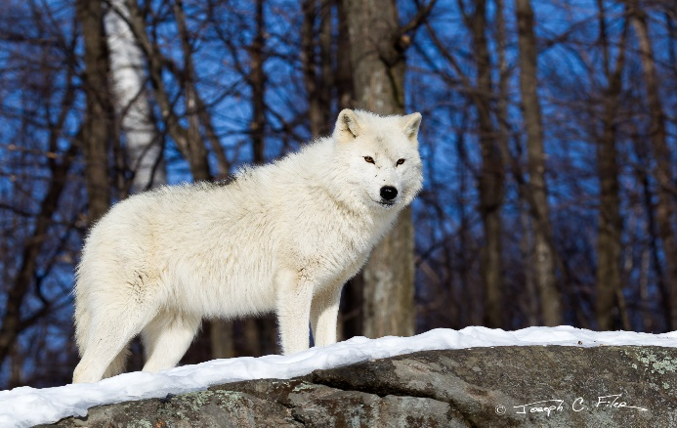
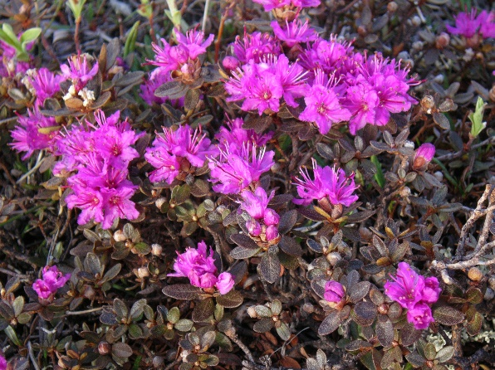
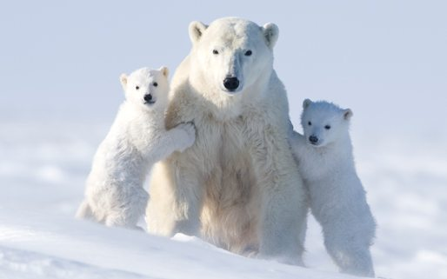
Mr. Jacklin Period 1 5/5/2020
Food Chain – Tundra Food Chain
Food chains show how energy flows through an ecosystem
Arctic Wolf
Secondary Consumer
“Carnivore”
Caribou
Primary consumer
“Herbivore”
Arctic Wild Flowers
“Producer”
Polar Bear

